Slide 2
CTWeather
Know your City’s Weather and forecast
Notes:
TITLE PAGE (ALT)
Footer is only editable feature.

Slide 3
CONTENTS
Introduction
Application features
Application Flow
Components And API Used
Notes:
TITLE PAGE (ALT)
Footer is only editable feature.

Slide 4
INTRODUCTION
'CTWeather’ is a weather information providing application.
It provides you the complete update of the weather condition at a place at a
given time and also gives the forecasted weather conditions for the next 13 days.
It uses openweathermap’s API as a data source.

Slide 5
Application Features
Home Screen – It provides an entry point for the application. On this page the user has
and option to see the weather of the favorite city selected or the user can
see the forecast summary for the coming 13 days.
Forecast Screen – By clicking on any of the forecasted day’s weather, the user can see
the complete weather detail of that day.
- The user can also navigate to and fro between the days by just swiping
to the left or right of the screen.
Detail Weather - It show the complete weather forecast details for the day being selected
Report Screen from the forecast screen. It allows the user to navigate to and fro by swiping
to the left or right of the screen.

Slide 6
City List – It provide the user with a list of city option which the user has added to
the list. This list is visible to the use from time to time in the navigation
drawer. The user can easily edit the list contents using –
‘Add Location’ - The user can select a city to add to the list from the set of predefined cities listed in this section.
‘Edit Location’ – This option provides the user with the facility to remove a city from his favorite list.

Slide 7
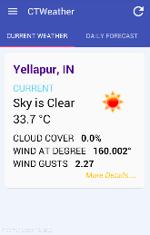
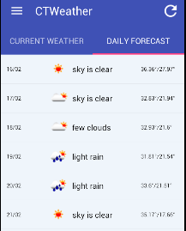
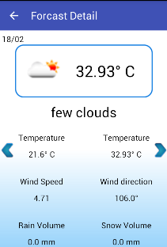
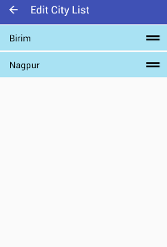
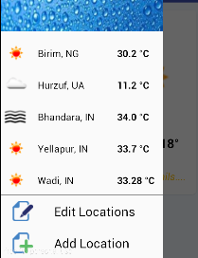
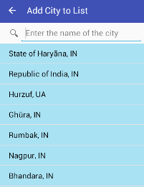
APPLICATION FLOW
Entry point
HOME SCREEN
FORECAST
EDIT CITY OPTION
CITY LIST
ADD CITY OPTION

Slide 8
COMPONENTS AND API USED
View Pager
List View
Http-Client/Http-Response
Sqlite DB(SqliteOpenHelper)
Recycler View
Drawer Layout

Slide 9
API Details
Being a Weather Information Provider app it is expected from it to provide the Correct weather information whenever Requested by the User.
The API required a use key for access which is obtained by registering on the Website.
Depending upon the user Input either of two Url will be prepared
api.openweathermap.org/data/2.5/weather?lat=35&lon=139
api.openweathermap.org/data/2.5/weather?q=London
api.openweathermap.org/data/2.5/weather?q=<city_code>

Slide 10
We can hit the API and fetch the data for the URL if it is available and it’s in String format(JSON String, XML String) .
Depending upon the String Format Appropriate Parsing Scheme will be applied over it and Data will be Extracted ,Now this intermediate data is needed to be Held Before it is Stored into the DataBase.
Data is available in different units-
Imperial
metric

Slide 11
Demonstration

Slide 12
Thank You
Thank you

